Slide 1
Cinterion IoT Embedded Processing
Nov 2021

Slide 2
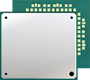
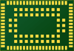



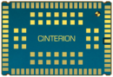
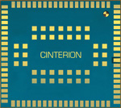
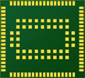



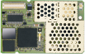
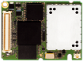
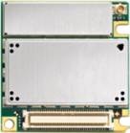
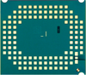

Cinterion Embedded Processing Evolution
2003
2004
2005
2006
2007
2008
2009
2010
2011
2012
2013
2014
2015
2016
2017
2018
2019
2020
2021
2022
Phase 3
Efficient, resource optimized platforms
PLS..
EXS..
TX..
Phase 2
First IoT focused Platforms
EHS5
EHS6
EHS8, PDS5
ELS6
Phase 1
Feature Phone Platforms
TC45
TC65
EGS5/TC65i
TC65i-X/EGS5-X
Notes:
Key messages:
Our 20 yrs experience and evolution of products with EP, and now we arrives at a phase of EP on optimized platform, where:
Efficient embedded systems
Best leverage of system resources
Highly integrated applications
Tying in sensors and other peripherals

Slide 3









Cinterion Embedded Processing & its SDK
Efficient Focused System
SDK
EMBEDDED PROCESSING
Efficient embedded systems
Best leverage of system resources
Highly integrated applications
Tying in sensors and other peripherals
IoT Application
Cinterion IoT
Embedded Processing
The Thales IoT SDK makes module’s onboard resources available for the application:
Processing
Memory
Interfaces
GNSS
Security
The Thales IoT SDK ties all these resources into a secure and flexible development environment, for easy and fast IoT application creation.
Processor
Memory
Interfaces
Security
Modem
GNSS
Notes:
Cinterion EP allows the Customers’ application to be placed inside the module itself, and allows application to access/use the module on-board resources, such as its memory, GNSS, interfaces and security.
Thales also provide a unique SDK to develop the application.

Slide 4




Main Elements for Embedded Processing
Cinterion IoT Embedded Processing
Leveraging Thales IoT Module onboard resources
Cinterion IoT SDK for Embedded Processing
Easy and flexible way to build a complete IoT Application
Security
Cinterion IoT Suite
IoT Application update over-the-air*
* in future releases
Notes:
Thales EP has 3 main elements: EP itself, SDK and IoT Suite to do the OTA application update, encapsulated by Thales security framework

Slide 5
General Advantages for Embedded Processing
Reduce Total Cost of Ownership
Optimize the Application
Shorten Time-To-Market
Improve BOM costs
Remove cost for processor and memory
No software license costs for OS and development tools
Process improvements
Simplified supply chain with less components and supplier dependencies
Build minimal space applications
Remove Processor space
Remove Memory space
Simpler power supply
Fast prototype and design
No extra hardware development for processing
Proven ready to go package
Leverage pre-integrated IoT building blocks
Maximize software reuse with industry standard software and tools
Notes:
With semicond supply issues nowadays, the role of EP has become more and more visible and critical
In the next slides, my colleague Jacques will present ‘why Thales SDK?’, what are the differences vs other module vendors?

Slide 6
Solution Technical Overview
Application Core
Cortex A7 @ 800MHz, 1520 DMIPS
The application core is running
Thread-X Operating System
Thales Service APIs: a set of IoT middleware libraries
OEM app
Typical OEM app Memory Profile (on EXS-TX)
Code: 512 KB
Volatile Data: 256 KB
Non Volatile Data (File System): 512 KB
OEM app has a direct access to hardware peripherals from application core
UART
Application Core
Cortex A7
@800MHz
EXT_IT
SPI
USB
I2C
ADC
GPIO
FLASH
64 MB
RAM
32 MB
shared memories
SIM
Modem Core
QDSP6
@576MHz
GNSS
RF
PCM/I2S

Slide 7





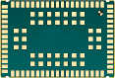


Supported Use Case
Standalone Mode
Cooperative Mode
Custom Modem
AT cmd
AT cmd
The complete OEM application is hosted inside the module
A external MCU driving the module through AT commands is offloading code inside the module
The OEM is extending the list of AT commands supported to resell a custom terminal (or module)

Slide 8
RunTime Architecture
Application binary
OEM Application
Service APIs
NIDD
MQTT
HTTP(S)
Watchdog
App Logging
Network
Control
Socket
(UDP, TCP, PING, IP v4, IP v6)
Secure Socket
(TLS, DTLS)
File System
GNSS
Safe Update
Serial Port
Power Mgmt
AT Client
Thread-X
OS & Drivers
USB
EXT_IT
I2C
UART
ADC
GPIO
SPI
Cortex A7
OEM app
Thales Services & Thread-X

Slide 9
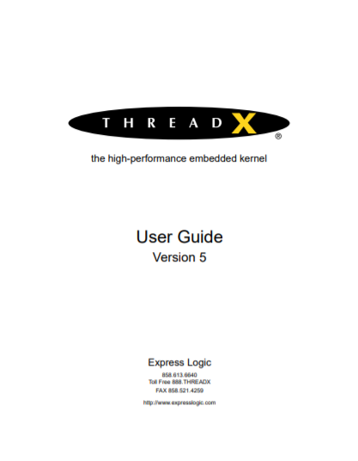
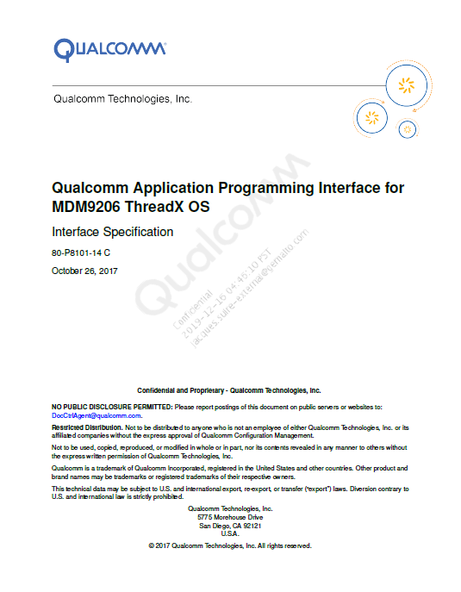
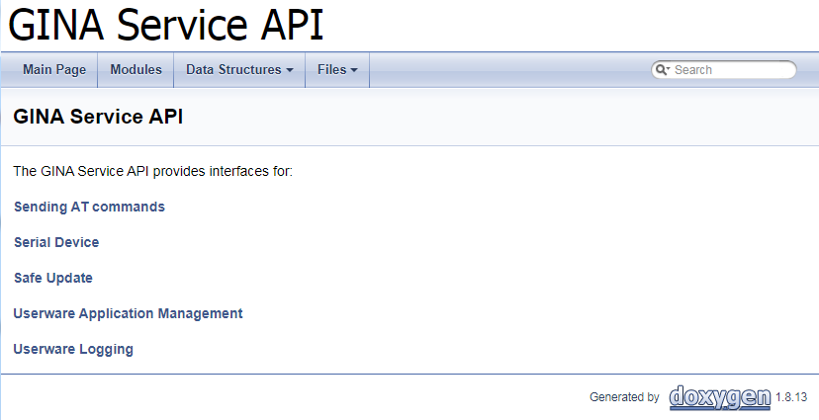
SDK Service APIs
Thales is exposing following Service APIs for OEM app
Thread-X RTOS API
For Operating System interface: ThreadX User Guide
Qualcomm QAPI
For hardware peripherals (I2C, ADC...)
For Sockets, IP protocols & File System
For modem functionalities
Thales GINA Service API
Unified serial interfaces (for any UART or USB-CDC ACM)
Safety procedures for software update
Application management (watchdog, cleanup) and logs
Security services

Slide 10


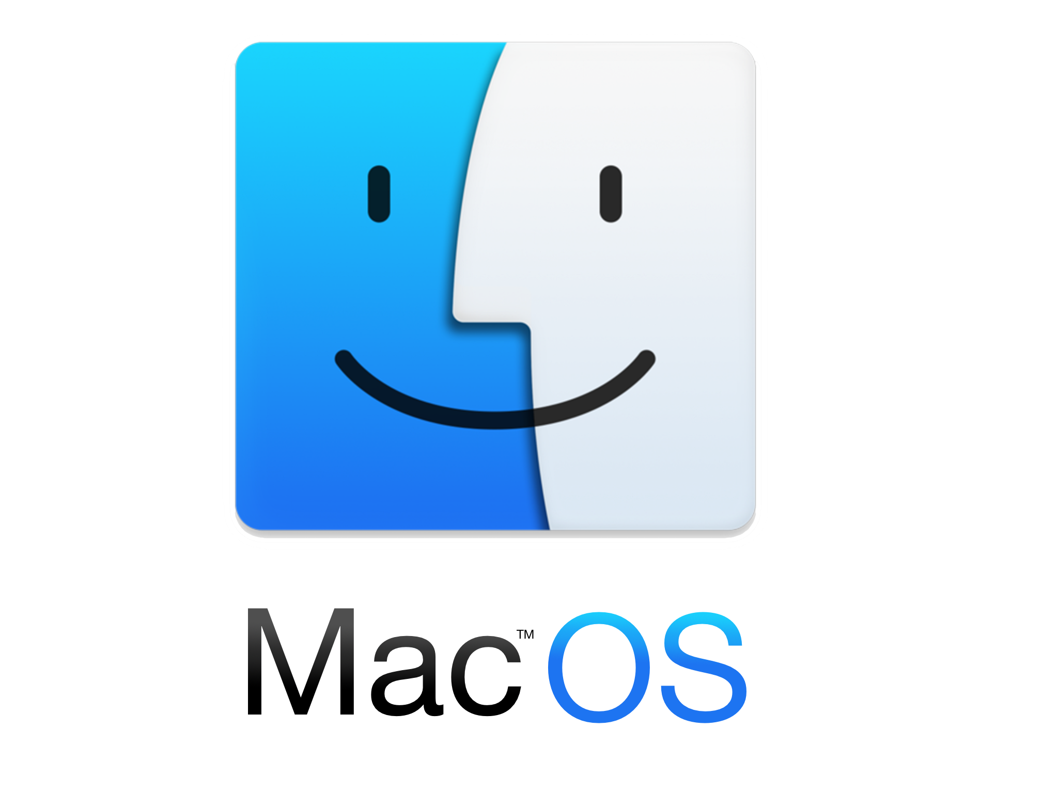


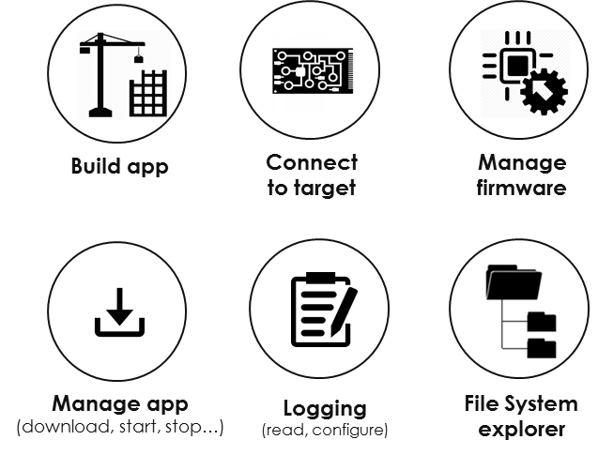
SDK Tools
Command line tools for an easy integration with Continuous Integration
Usable from Windows and Linux host
Target connection primarily through USB
Tools for
Building the OEM app inc. toolchain and cross compiler
Downloading the OEM app into the module
Configuring & getting logs from the OEM app
Through dedicated serial port (any physical UART or logical USB port)
Through URC multiplexed into an AT channel
Exploring the application core File System
UART
SPI
USB
I2C
GPIO
EXT_IT
ADC

Slide 11



SDK Service APIs – GINA Application Management
Watchdog Reset
System reset if your application falls into infinite loop
Resource cleanup
Callback to properly release your resources in case of application stop/update
Custom Update procedure
Update firmware or application
Either locally (e.g. UART) or remotely (e.g. HTTP)

Slide 12
SDK – Errors & Exceptions Management
Backtrace
Get the last called functions before a crash
Exception Handler
Catch exceptions for unauthorized memory or resource access
Configure behavior depending on error type
Ignore
Restart app
Restart app wo. data re-initialization
Stop & unload app
user@host:~$ python backtrace.py process exception3 1 ..\examples\exception3 .
Process Dump 1 of APP exception3...
Received 100 %
sp is 0x43004c78, stackStart is 0x43003d30
lr is 0x43000254
pc is 0x430001e8
*** Exception occurred at PC 0x430001e8 in function Func3 at line #139
in exception3.c
*** Called from 0x43000250 in function Func2 at line #154 in exception3.c
*** Called from 0x43000278 in function Func1 at line #162 in exception3.c
*** Called from 0x430002f8 in function _APP_main at line #184 in exception3.c
LR 0x0 - end of call stack detected

Slide 13
SDK – Secure your application
Application Signing
Prevent malware injection
Using your own key pair
PuK/certificates stored in Thales certificate store
Reduce interfaces & commands
Locking peripheral interfaces (UART, SPI, …)
Locking commands on AT Interfaces
Locking File System rights & access
Locking Userware app & logs
IoT Application
Certificate Store
Firmware
eFUSE

Slide 14

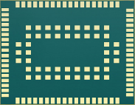


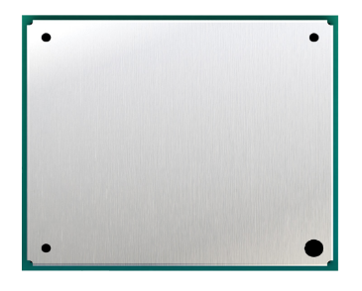






Cinterion Embedded Processing Products
2021 H1
2021 H2
2021 H2
EXS62 / EXS82
TX62 / TX82
PLS63 / PLS83
Phase 3
Efficient, resource optimized platforms
PLS..
EXS..
TX..
IoT Application
IoT Application
IoT Application
Cinterion IoT
Embedded Processing
Cinterion IoT
Embedded Processing
Cinterion IoT
Embedded Processing

Slide 15

Customers

Slide 16

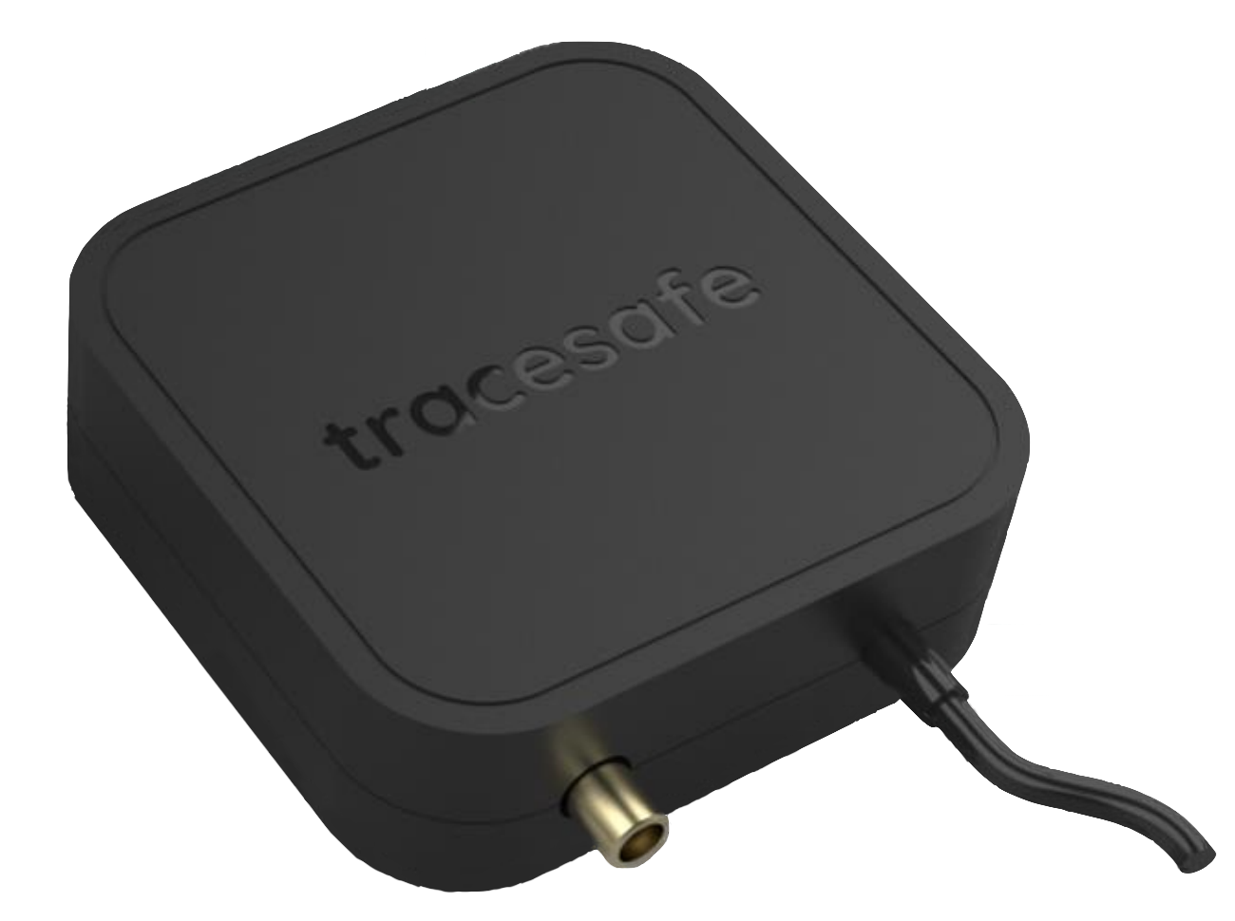
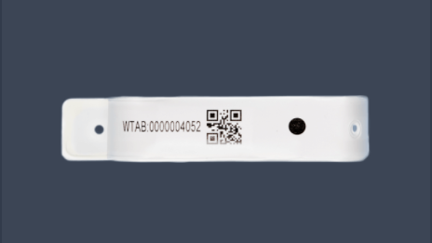
Tracesafe LTE-M Gateway – Singapore (ASEAN)
Company: | TraceSafe
Country: | Singapore
Product name: | LTE-M Gateway
Module: | EXS82-W
https://www.tracesafe.io/
Gateways are the glue that holds the TraceSafe wearable ecosystem together. Placed strategically around your location, they extract real-time information and upload it to the cloud securely.
Product description:
Connects Bluetooth Low Energy (BLE) devices to LTE-M network
Built-in internal antenna, with an unobstructed range of 14 meters / 15 yards
61.7mm x 61.7mm x 2mm
Thales IoT Embedded Processing and its SDK are easy to use, and have saved us efforts and bill of material cost by eliminating the need for an additional MCU in our design
-Jasling Ong (Managing Director of Tracesafe Asia Pacific)

Slide 17


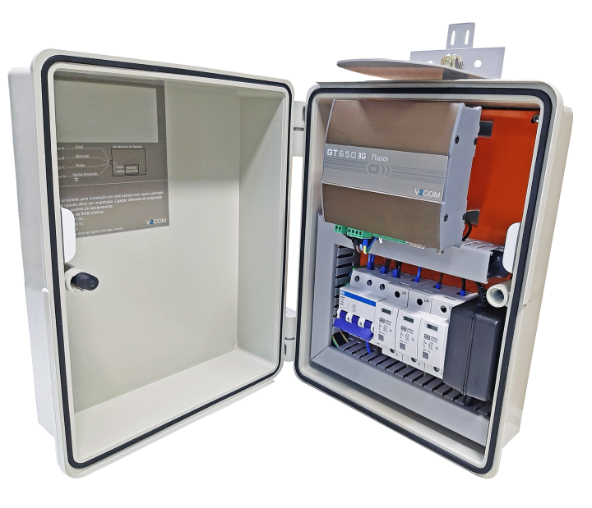
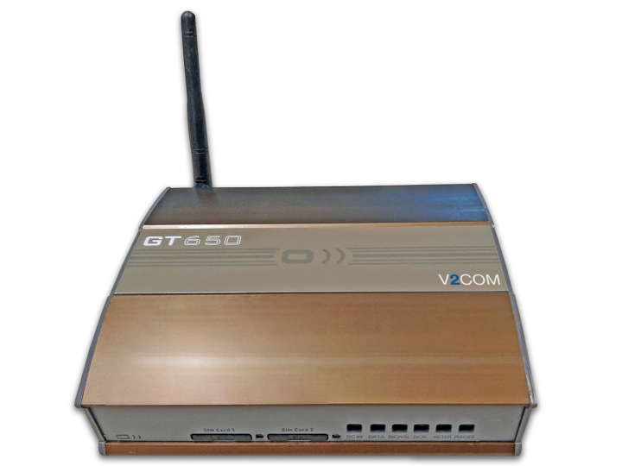
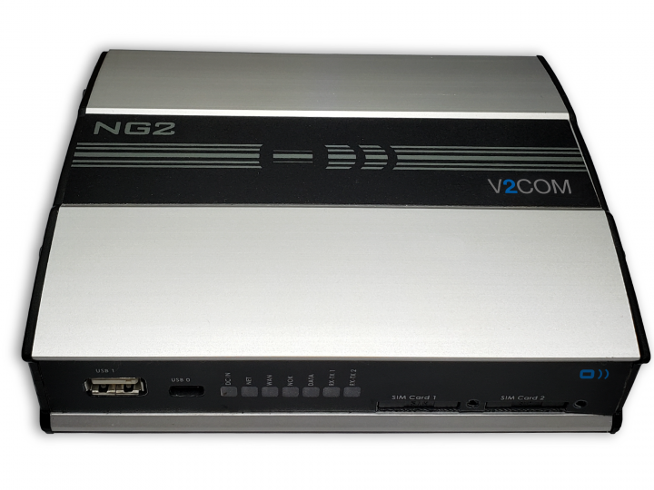
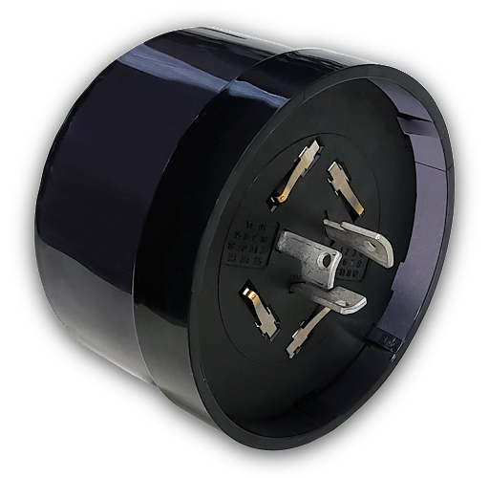
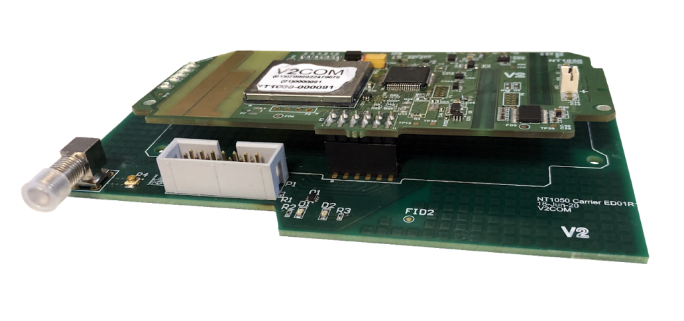

Água | Agronegócio | Energia | Indústria 4.0 | Petróleo e Gás | Smart City
EHS6
Thales and V2COM Partnership
Thales Embedded Processor is key for our products both on EHS6 with our Java powered application that can solve our complex business processes and EXS82 where our ConeraTM Middleware process the data to provide edge intelligence and better uses the Cellular LPWA connectivity
Thales SDK as well is deeply important as allow V2COM to abstract operations that would require effort of coding and testing, allowing V2COM team to focus on business application needs and reuse basic modules.
Frederico Vieira
Technology Development Manager
NG2
GT650
GTPhases
EXS82/62
Motelight MTL31
NIC NT1050X

